Slide 1
Introduction to
Statistical Methods
ISM Team

Slide 2
Session 7
( 6th Sep2026)
Sampling and Distribution

Slide 3
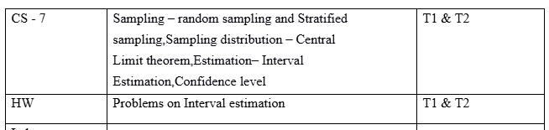
Contact Session 7

Slide 4
Agenda
Random Sampling
Sampling Distribution and Central Limit Theorem,
Point Estimation
Interval Estimation
Confidence Interval

Slide 5
Population and Sample
POPULATION (Big data or Huge or Massive data)
A population is the aggregate of facts (Data). It is the set of all elements of interest for a specific Aim and Objectives. The process of conducting a survey to collect data for the entire population is called a census.
SAMPLE (Small data)
A sample is a subset of the population. The process of conducting a survey to collect data for a sample is called a sample survey.

Slide 6
Basic Terminology
Statistics uses data from a sample to make estimates and
Testing of hypotheses about the characteristics of a population in the point of view of minimising the resources (Money, Manpower, Material and Time – 3MT).
This process of Statistics is called Inferential statistics.
Notes:
6

Slide 7
Parameter and Statistic
Parameter:
It is population constants, whose values generally unknown
The various statistical characteristics or constants of a population are:
  Population Mean (μ), Population Variance (σ²), Population Proportion (P), Population Correlation Coefficient (ρ) etc.
Example: Binomial distribution (n, p)
Poisson distribution (λ)
Normal distribution (μ, σ²)

Slide 8
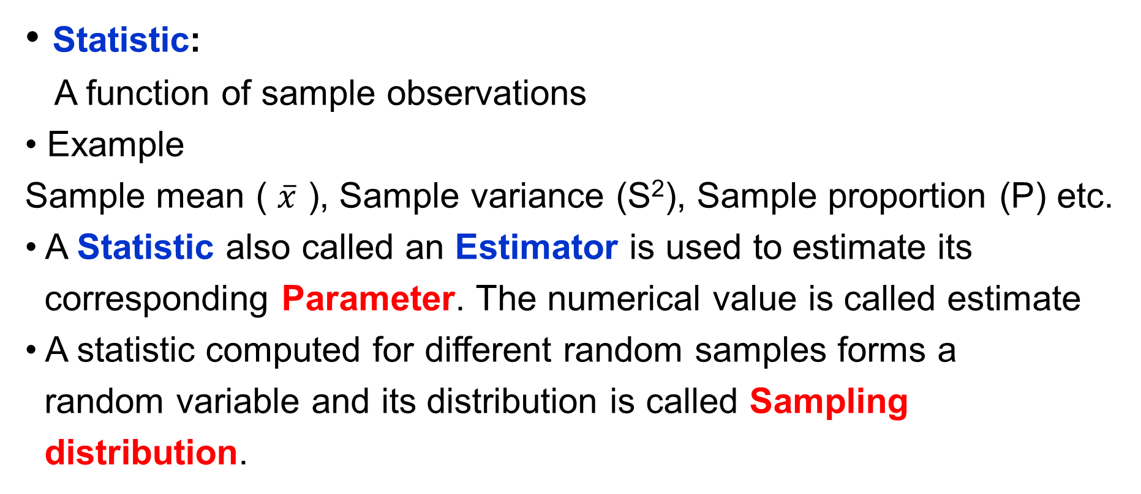
Parameter and Statistic

Slide 9
Sampling
Sampling is a process of selecting samples from a well-defined target populations. A target population is a population characteristic in which the Analyst is interested. For instance, the coping problem of all adolescents with elders.
If the representative samples are selected from the well-defined target population which are also consistent and accurate, then the estimates obtained from such samples help in better generalization of the unknown parameters. This process is known as Inferential Statistics which forms a good scientific decision-making tool.

Slide 10
Reasons for Sampling
Most often the population under study may be either unknown or infinite. Collecting data from such population is not feasible. Further, even if the population is countably finite, the resources required to collect data may be huge. Hence, by selecting representative samples from the target population, not only the resources can be minimized but also a close estimation of parameters can be made.

Slide 11
Continued…
Collecting data from samples instead of population offers several Advantages:
The sample can save money.
2. The sample can save time.
3. For given resources, the sample can broaden the scope of the study.

Slide 12



Methods of Selection of Sample
The data obtained from the samples are the observable data
Observed data = Truth + Bias + Random error
Procedure that assures all the units in the population have some probabilities known in advance of being chosen in a sample
Procedures in which units in the sample are collected with no specific probability structure

Slide 13
Methods for Selection of Sample
► Probability sampling
Simple Random Sampling
Systematic Random Sampling
Multistage Random Sampling
Stratified Random Sampling
► Non – Probability sampling
Purposive / Judgement Sampling
Convenience Sampling
Quota Sampling
Snowball Sampling

Slide 14
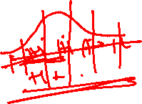
Methods of Selection of Sample
The requirement for simple random sampling is
  Homogeneous and finite target population
  Samples are selected unit by unit with equal probability
The requirement for systematic random sampling is
  Sampling frame (Listing of sampling units from finite population)
  All units must be arranged in a systematic order ( The order may be w.r.t alphabets, date of births, Adhaar numbers, telephone numbers.. etc)
  Only the first unit is selected at random for the sample
  Remaining units are selected at a regular interval of k (k = N/n)

Slide 15
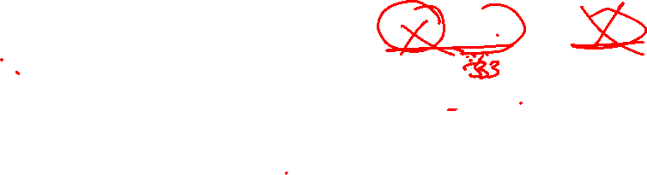
Stratified Random Sampling
The requirement for Stratified random sampling is
  Heterogeneous target population
  Divide the heterogeneous target population into different stratum by ensuring homogeneity within each stratum
  Use simple random sampling within each stratum to select samples proportional to population size
  For example, if there are three stratum with respective population sizes 2000, 6000, and 1000. The sample size is 1500, then with probability proportional to population size (PPPS) the respective samples are 333, 1000 and 167. (eg., 2000x1500/9000=333)
  Obtain the estimates from each stratum and compute an estimate by weighted average.

Slide 16
Sampling Error
  which occurs when the sample is not a representative of the population.
  Improper sampling techniques used for selecting the samples.
  Sampling error is proportionate to sampling variation.

Slide 17

Sampling Variation
Population of Wages of employees of an organization
1861 | 2495 | 1000 | 2497 | 1865 | 791 | 2090 | 2637 | 1327 | 1678
1680 | 2858 | 795 | 2495 | 2496 | 2501 | 1160 | 1480 | 1860 | 2490
2090 | 2840 | 2490 | 2640 | 659 | 827 | 2646 | 2638 | 2643 | 868
1327 | 1866 | 1861 | 2486 | 2865 | 3011 | 2494 | 1489 | 1865 | 2855
2840 | 2499 | 2093 | 2660 | 1165 | 2600 | 2085 | 2640 | 2998 | 1861
2956 | 2495 | 2865 | 1865 | 3000 | 3019 | 1670 | 2858 | 2642 | 1680
3038 | 3000 | 1313 | 596 | 656 | 3240 | 590 | 2501 | 2485 | 3015
2092 | 1679 | 3024 | 2497 | 2825 | 2630 | 2070 | 2900 | 1861 | 2636
2495 | 2637 | 2497 | 1159 | 2640 | 3050 | 870 | 2896 | 2500 | 2638
926 | 2860 | 1481 | 875 | 2482 | 1860 | 2086 | 934 | 3200 | 2490

Slide 18
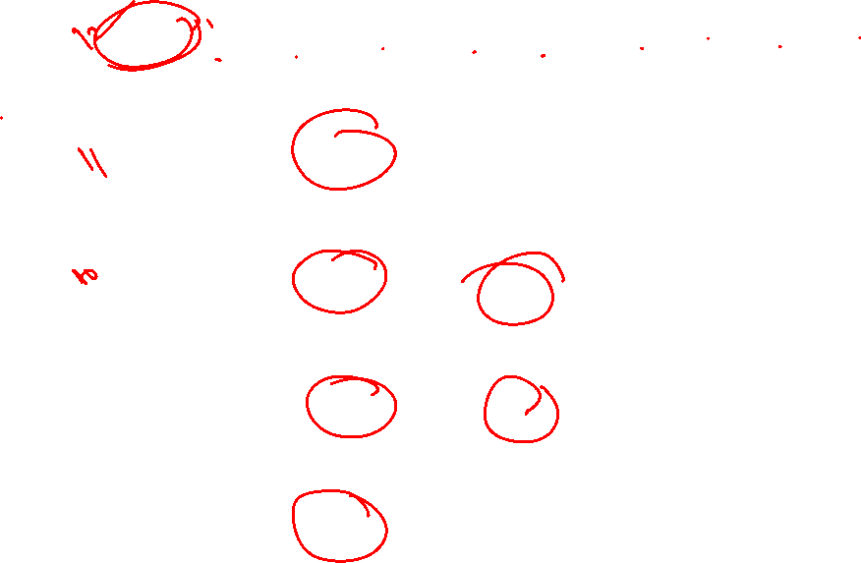
Selecting Samples of Different Sizes
Sample 1
3000 | 2486 | 820 | 1678 | 2070 | 2638 | 2490 | 1865 | 1000 | 2090 | 596 | 3200
Sample 2
2840 | 2858 | 3000 | 2490 | 2998 | 3050 | 2070 | 2896 | 3200 | 2490 | 3280
Sample 3
2858 | 3240 | 2497 | 2865 | 656 | 2093 | 934 | 1861 | 868 | 795
Sample 4
2086 | 1000 | 2497 | 596 | 656 | 875 | 2085 | 934 | 1313
Sample 5
820 | 1313 | 3000 | 2640 | 596 | 2640 | 2600 | 2495 | 934 | 2500

Slide 19
Continued….
Sample 6
2840 | 2499 | 1327 | 1861 | 2495 | 3024 | 3038 | 2497
Sample 7
2858 | 2490 | 868 | 1670 | 1480 | 2643 | 1480 | 1680 | 2085 | 2490
Sample 8
2495 | 2858 | 1861 | 2092 | 2499 | 3000 | 2660 | 1000 | 1679 | 926 | 2660
Sample 9
795 | 791 | 3200 | 2085 | 2638 | 2497 | 2486 | 1159 | 2640
Sample 10
3019 | 3240 | 3200 | 3050 | 3000 | 3015 | 2900 | 2896 | 2998

Slide 20
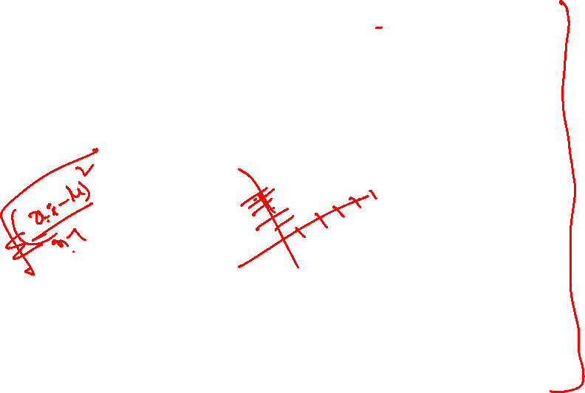
Calculation of Mean and Variance
Sample No. | Sample size | Mean | SD | Variance
1 | 12 | 1994.42 | 843.23 | 711036.83
2 | 11 | 2830.18 | 349.94 | 122458.00
3 | 10 | 1866.70 | 988.57 | 977270.64
4 | 9 | 1338.00 | 704.36 | 496123.01
5 | 10 | 1953.80 | 920.44 | 847209.79
6 | 8 | 2447.63 | 590.64 | 348855.61
7 | 10 | 1974.40 | 638.05 | 407107.80
8 | 11 | 2157.27 | 715.1 | 511368.01
9 | 9 | 2032.33 | 891.53 | 794825.74
10 | 9 | 3035.33 | 117.4 | 13782.76
Overall | 100 | 2162.24 | 732.26 | 536204.71

Slide 21
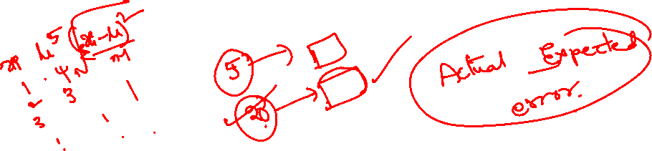
Sampling Variation
The term "sampling variation" refers to the fact that the sampling estimates vary from one sample to another forming a random variable.
Sampling variability will decrease as the sample size increases.
The samples must be randomly chosen. The size of the samples should be optimum (neither too small nor too large). The required optimum sample size are computed based on some statistical procedures like proportion, SD etc.

Slide 22
Sampling Distribution Definition
The probability distribution of a statistic (sample estimate) is called sampling distribution.
The sampling distribution of a statistic depends on the distribution of the population, the size of the sample, and the method of sample selection

Slide 23
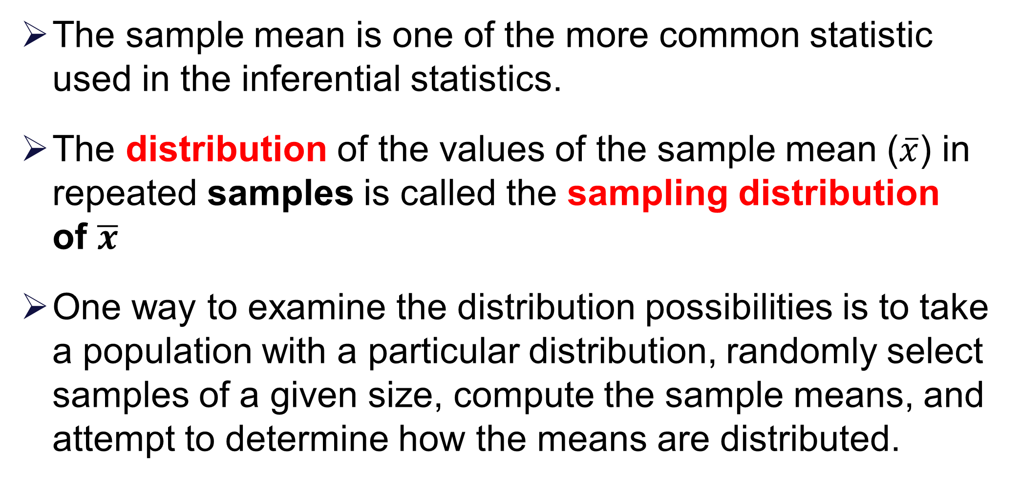

Slide 24
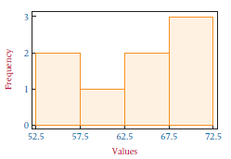
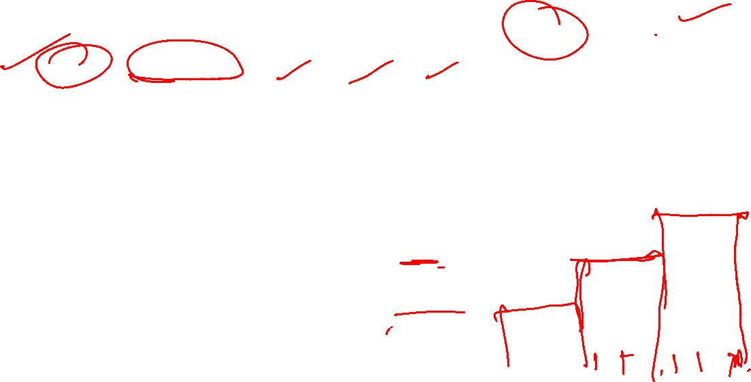
Example
Suppose a small finite population consists of only N = 8 numbers: 54, 55, 59, 63, 64, 68, 69, 70
Using an Excel-produced histogram, we can see the shape of the distribution of this population of data.
Suppose we take all possible samples of
size n = 2 from this population
with replacement.

Slide 25

Sample of Size 2
The result is the following pairs of data
(54,54) (55,54) (59,54) (63,54)
(54,55) (55,55) (59,55) (63,55)
(54,59) (55,59) (59,59) (63,59)
(54,63) (55,63) (59,63) (63,63)
(54,64) (55,64) (59,64) (63,64)
(54,68) (55,68) (59,68) (63,68)
(54,69) (55,69) (59,69) (63,69)
(54,70) (55,70) (59,70) (63,70)
(64,54) (68,54) (59,54) (70,54)
(64,55) (68,55) (69,55) (70,55)
(64,59) (68,59) (69,59) (70,59)
(64,63) (68,63) (69,63) (70,63)
(64,64) (68,64) (69,64) (70,64)
(64,68) (68,68) (69,68) (70,68)
(64,69) (68,69) (69,69) (70,69)
(64,70) (68,70) (69,70) (70,70)
The means of each of these samples follow
54.5 56.5 58.5 59 61 61.5 62
54.5 55 57 59 59.5 61.5 62 62.5
56.5 57 59 61 61.5 63.5 64 64.5
58.5 59 61 63 63.5 65.5 66 66.5
59.5 61.5 63.5 64 66 66.5 67
61.5 63.5 65.5 66 68 68.5 69
61.5 62 64 66 66.5 68.5 69 69.5
62 62.5 64.5 66.5 67 69 69.5 70

Slide 26
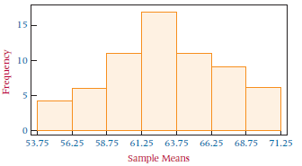
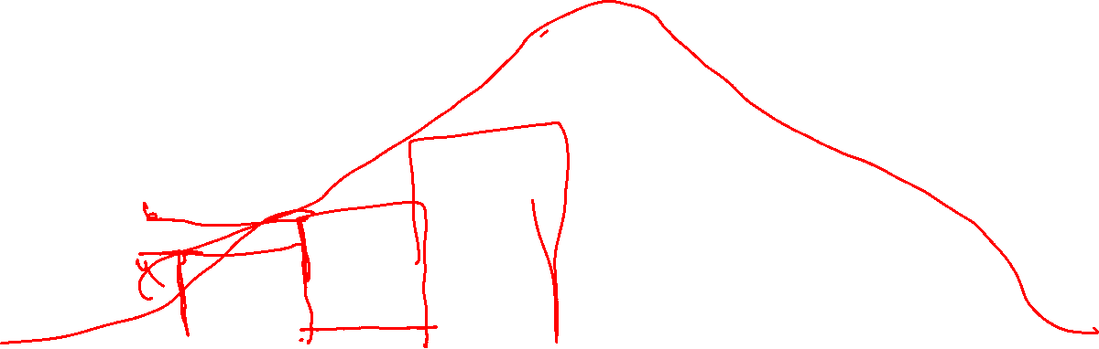
Sampling Distribution
Again, using an Excel-produced histogram, we can see the shape of the distribution of these sample means.
Notes:
26

Slide 27

Conclusion
Observe that the shape of the histogram for sample means is quite unlike the shape of the histogram for the population.
The sample means appear to “pile up” toward the middle of the distribution and “tail off” toward the extremes.
As sample sizes become much larger, the sample mean distributions begin to approach a Normal distribution and the variation among the means decreases.

Slide 28
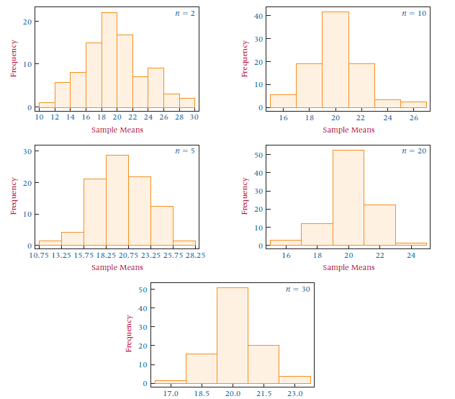
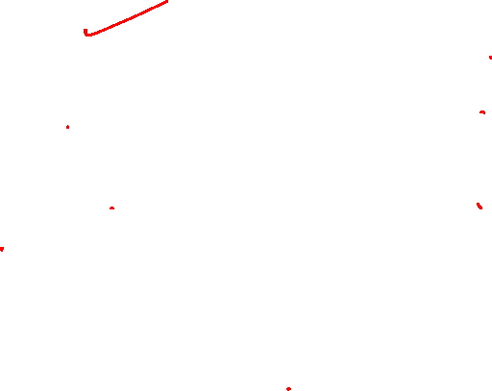
Sampling Disrtibution Analysis
Sample Means from 90 Samples Ranging in Size from
n = 2 to n = 30 from a Uniformly Distributed Population with a = 10 and b = 30

Slide 29
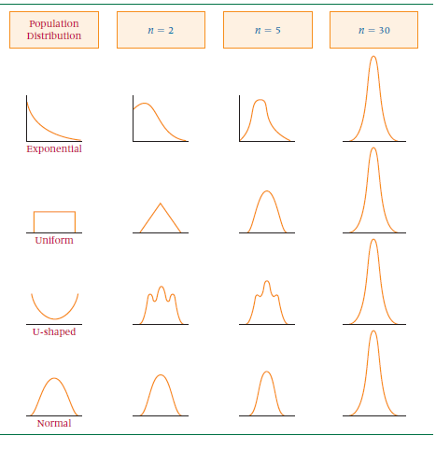
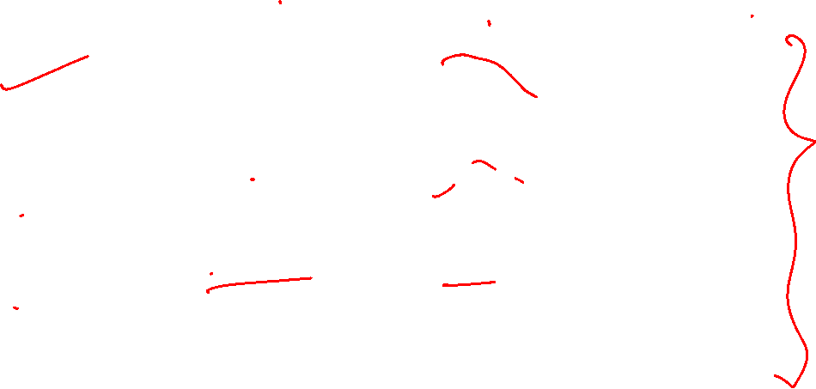
Shapes of the Distributions of Sample Means

Slide 30
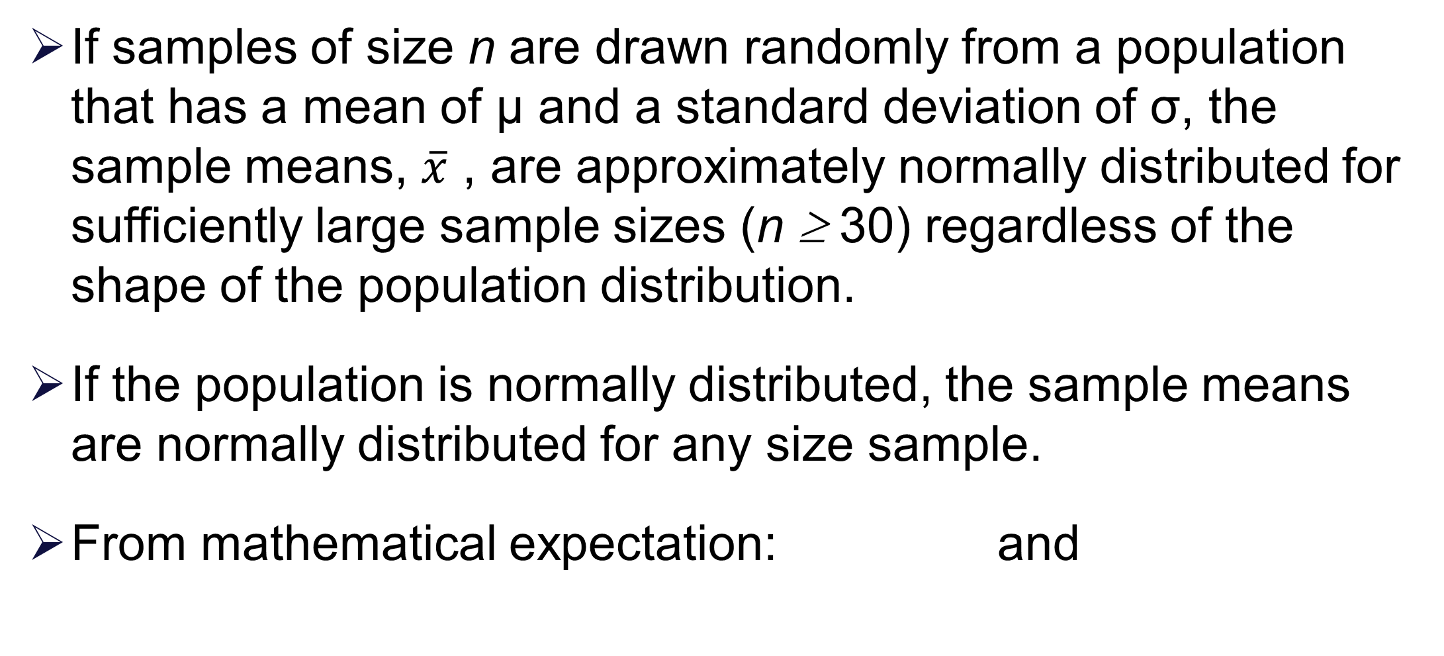
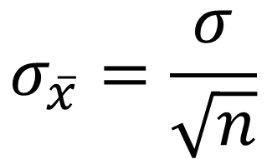
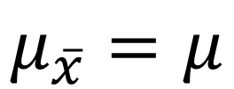
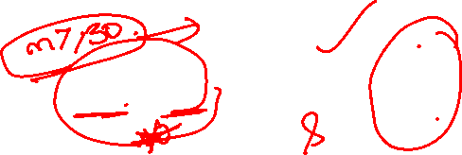
Central Limit Theorem

Slide 31
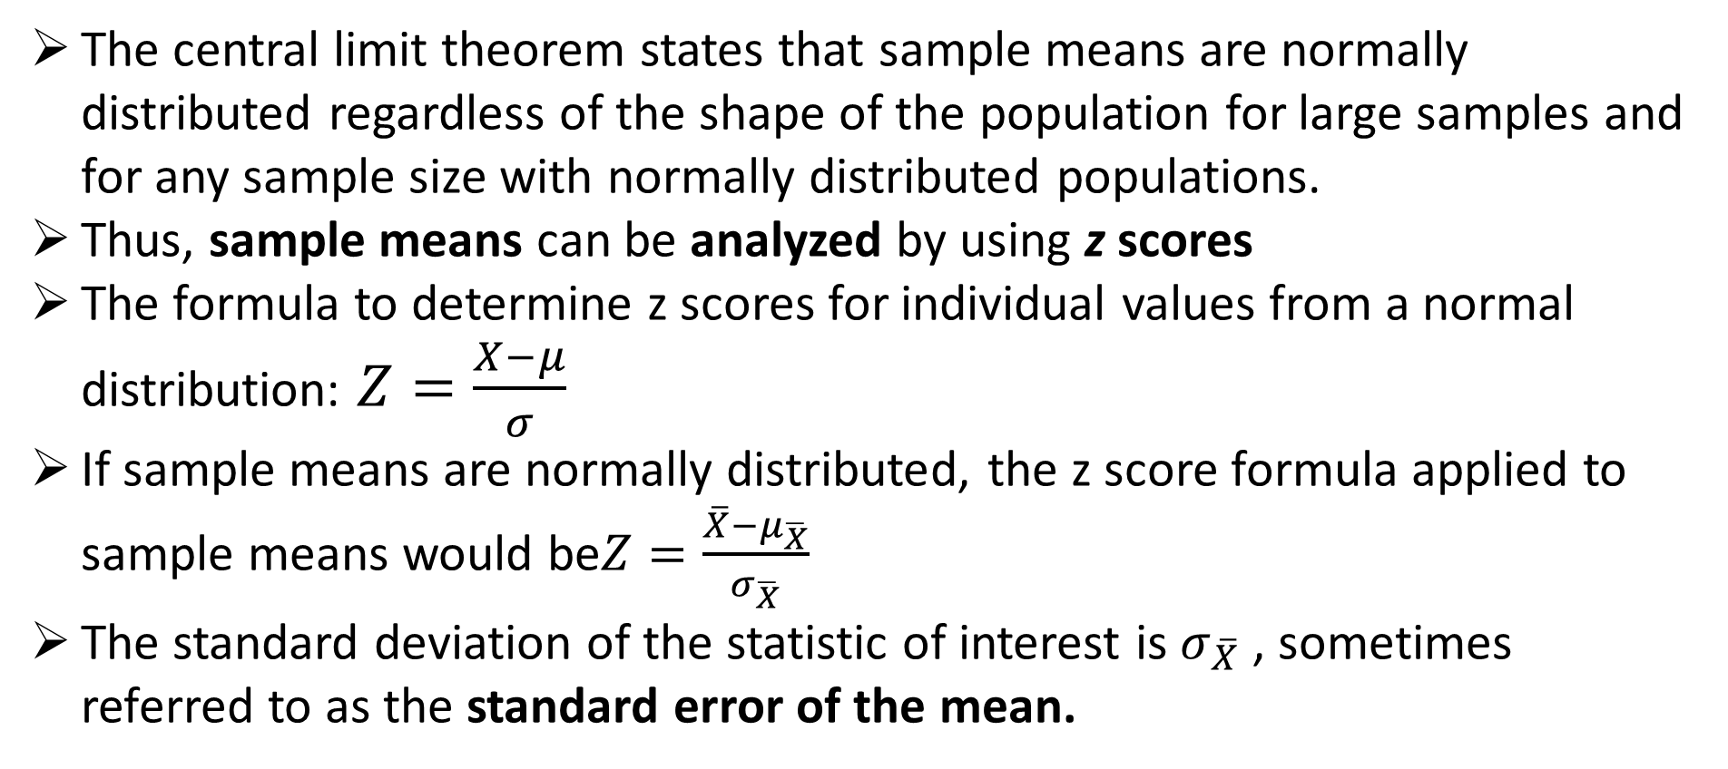
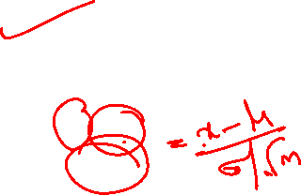
Z score for sample means

Slide 32

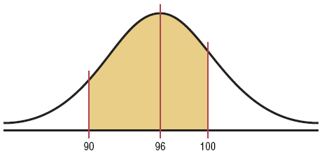
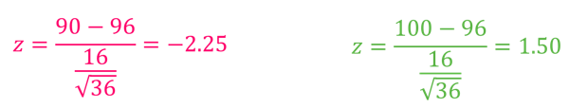
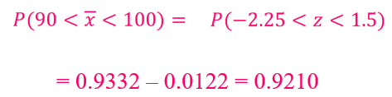
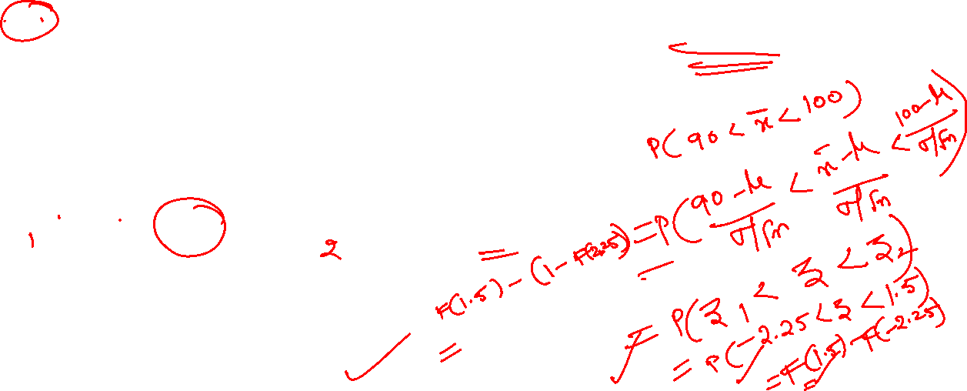
Example-1
The average age of a vehicle registered in the United States is 8 years, or 96 months. Assume the standard deviation is 16 months. If a random sample of 36 vehicles is selected, find the probability that the mean of their age is between 90 and 100 months.

Slide 33
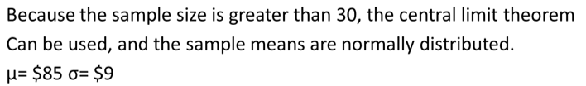
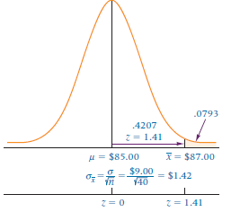

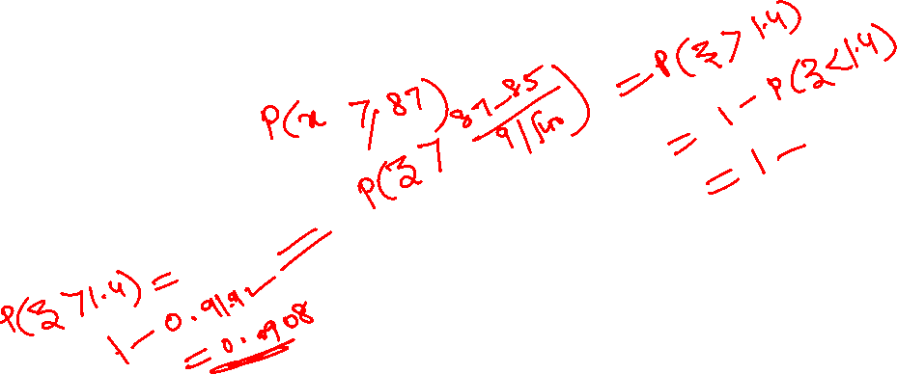
Example-2
Suppose the mean expenditure per customer at a tire store is $85.00, with a standard deviation of $9.00. If a random sample of 40 customers is taken, what is the probability that the sample average expenditure per customer for this sample will be $87.00 or more?
Solution:

Slide 34
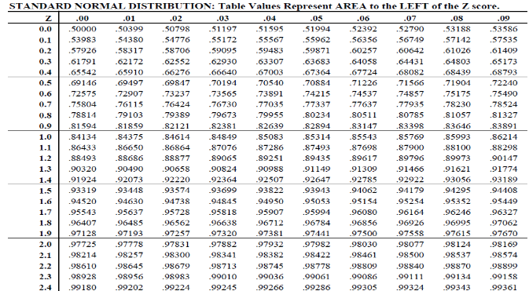



Slide 35
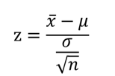
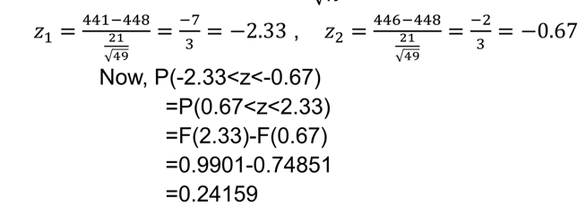
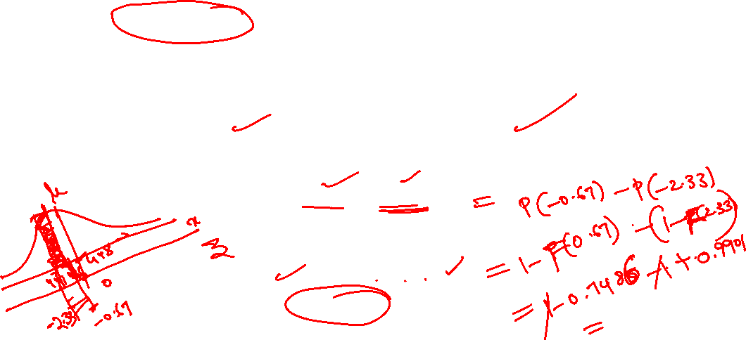
Example-3
Suppose that during any hour in a large department store, the average number of shoppers is 448, with a standard deviation of 21 shoppers. What is the probability that a random sample of 49 different shopping hours will yield a sample mean between 441 and 446 shoppers?

Slide 36
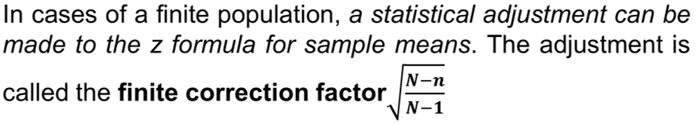
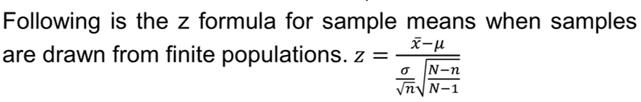

Finite Population Sampling

Slide 37
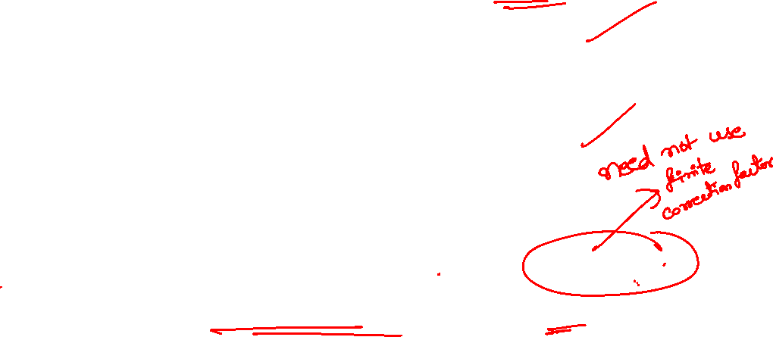
Note about Finite Population
As the size of the finite population becomes larger in relation to sample size, the finite correction factor approaches 1.
In theory, whenever researchers are working with a finite population, they can use the finite correction factor.
A rough rule of thumb for many researchers is that, if the sample size is less than 5% of the finite population size or n/N < 0.05, the finite correction factor does not significantly modify the solution.

Slide 38
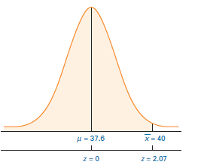
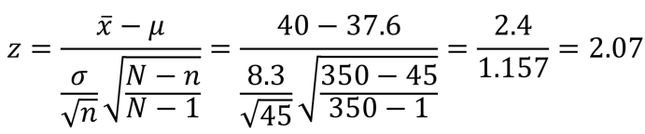
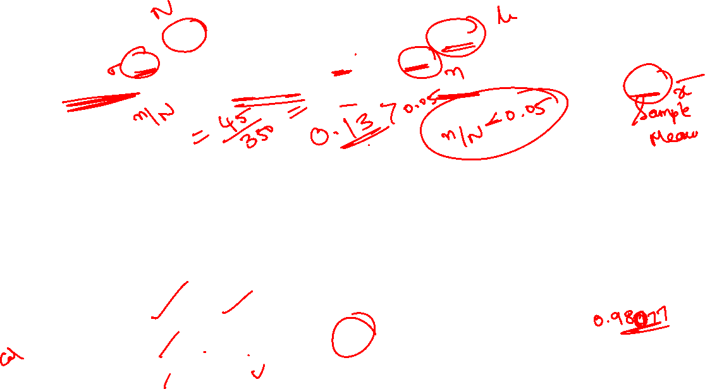
Example-4
A production company’s 350 hourly employees average 37.6 years of age, with a standard deviation of 8.3 years. If a random sample of 45 hourly employees is taken, what is the probability that the sample will have an average age of less than 40 years?
Solution: The population mean is 37.6, with a population standard deviation of 8.3. The sample size is 45, but it is being drawn from a finite population of 350; that is, n = 45 and N = 350. The sample mean under consideration is 40. Using the z formula with the finite correction factor gives
Thus, P(z<2.07) = 0.9808 is the required probability.

Slide 39
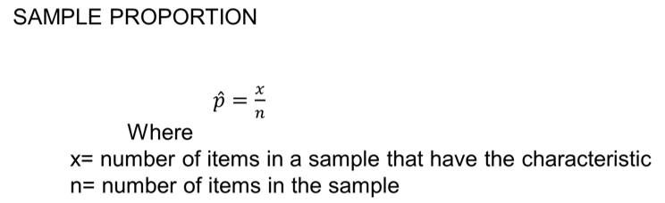
Sampling Distribution of Sample Proportion
If research results in countable items such as how many elements satisfy a certain property or characteristic, the sample proportion is often the statistic of choice.

Slide 40
Example
In a sample of 100 factory workers, 30 workers might belong to a union. The value of sample proportion for this characteristic, union membership, is 30/100 = 0 .30

Slide 41
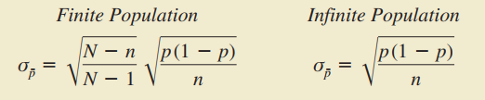
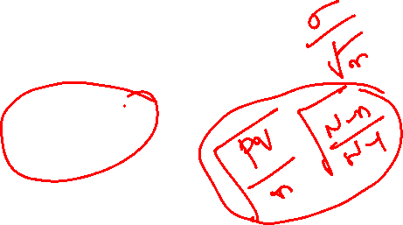
Central Limit Theorem for Sample Proportion
The central limit theorem applies to sample proportions is that the normal distribution approximates the shape of the distribution of sample proportions
If n*p > 15 and n*q > 15 (p is the population proportion and q = 1 - p).
The mean of sample proportions for all samples of size n randomly drawn from a population is p (the population proportion) and
the standard deviation of sample proportions (sometimes referred to as the standard error of the proportion) is given by

Slide 42
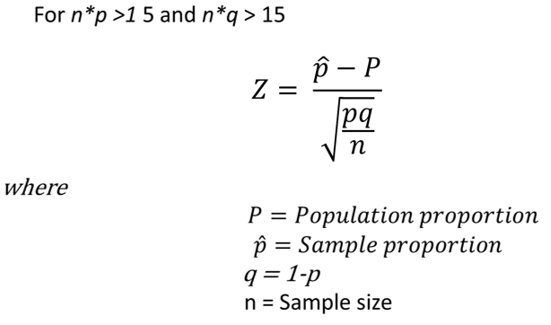
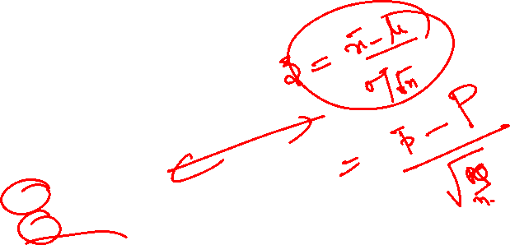
Z Formula for Sample Proportion

Slide 43
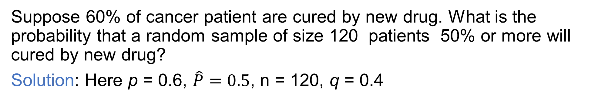
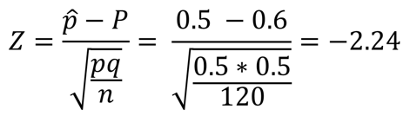
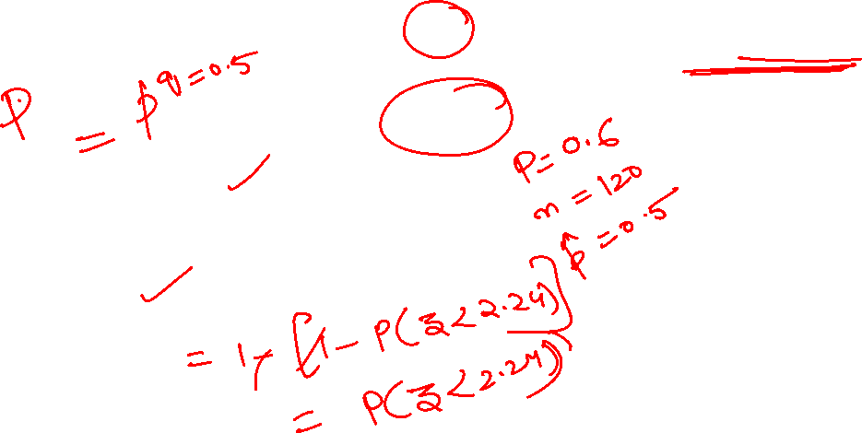
Example-4
Therefore, P(z > -2.24)
= 1- P(z<-2.24)
= 1- 0.0125 = 0.9875

Slide 44
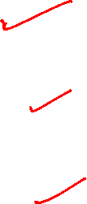
Statistical Inference
Three forms of statistical inference
Point estimation
Interval estimation
Hypothesis testing

Slide 45
Point Estimate
A point estimate is a statistic taken from a sample that is used to estimate a population parameter.
A point estimate is only as good as the representativeness of its sample.
If other random samples are taken from the population, the point estimates derived from those samples are likely to vary.

Slide 46
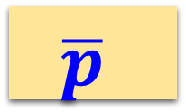
Terminology and Notations
Statistical measure
Sample
estimates
Population parameter
Mean
x
µ
Variance
s²
σ²
Proportion
P
Correlation
r
ρ

Slide 47
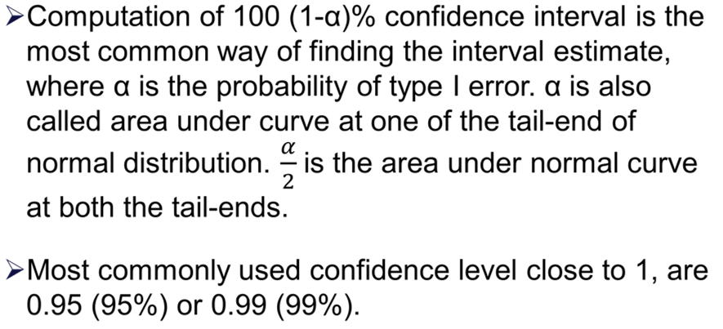

Confidence Interval

Slide 48

Graphical Representation of Confidence Interval

Slide 49




α in Confidence Intervals

Slide 50




Confidence Interval For Mean
The 100 (1-α)% confidence interval for mean is
Based on Standard normal distribution 100 (1-α)% CI for µ is
For α = 0.05,
For α = 0.01,

Slide 51




Confidence Interval for Difference of Mean of Two Populations
The 100 (1-α)% confidence interval for difference in means of two populations is
Based on Standard normal distribution 100 (1-α)% CI is
For α = 0.05,
For α = 0.01,

Slide 52


Example
In the cellular telephone company, problem of estimating the population mean number of minutes called per residential user per month, from the sample of 85 bills it was determined that the sample mean is 510 minutes. Suppose past history and similar studies indicate that the population standard deviation is 46 minutes.Determine a 95% confidence interval.

Slide 53




Example
A study is conducted in a company that employs 800 engineers. A random sample of 50 engineers reveals that the average sample age is 34.3 years. Historically, the population standard deviation of the age of the company’s engineers is approximately 8 years. Construct a 98% confidence interval to estimate the average age of all the engineers in this company.

Slide 54

Example
A survey was taken of U.S. companies that do business with firms in India. One of the questions on the survey was: Approximately how many years has your company been trading with firms in India? A random sample of 44 responses to this question yielded a mean of 10.455 years. Suppose the population standard deviation for this question is 7.7 years. Using this information, construct a 90% confidence interval for the mean number of years that a company has been trading in India for the population of U.S. companies trading with firms in India.

Slide 55


Solution

Slide 56

Practice Problem-1
In an effort to estimate the mean amount spent per customer for dinner at a major Atlanta restaurant, data were collected for a sample of 49 customers. Assume a population standard deviation of $5. a. At 95% confidence, what is the margin of error? b. If the sample mean is $24.80, what is the 95% confidence interval for the population mean?
Solution:

Slide 57


Practics Problem-2

Slide 58
Practice Problem-3
A political pollster is conducting an analysis of sample results in order to make predictions on election night. Assuming a two-candidate election, if a specific candidate receives at least 55% of the vote in the sample, then that candidate will be forecast as the winner of the election. If you select a random sample of 100 voters, what is the probability that a candidate will be forecast as the winner when
a. the true percentage of her vote is 50.1%?
b. the true percentage of her vote is 60%?
c. the true percentage of her vote is 49% (and she will lose the election)?
d. If the sample size is increased to 400, what are your answers to (a) through (c)?

Slide 59

Solution

Slide 60
Practics Problem-4
The following data represent the bounced cheque fee, in dollars, charged by a sample of 23 banks for direct-deposit customers who maintain a $100 balance:
26, 28, 20, 20, 21, 22, 25, 25, 18, 25, 15, 20, 18, 20, 25, 25, 22, 30, 30, 30, 15, 20, 29
Construct a 95% confidence interval for the population mean bounced cheque fee.
Interpret the interval constructed in (a)
Solution:
(a) $21.01 to $24.99.
(b) You can be 95% confident that the population mean bounced-cheque fee is between $21.01 and $24.99

Slide 61

Practice Problem-5
A survey is planned to determine the mean annual family medical expenses of employees of a large company. The management of the company wishes to be 95% confident that the sample mean is correct to within $50 of the population mean annual family medical expenses. A previous study indicates that the standard deviation is approximately $400.
How large a sample size is necessary?
If management wants to be correct to within $25, what sample size is necessary?
Solution:

Slide 62
Glossary
Population
Sample
Random sampling
Stratified sampling
Parameter
Statistics
Sampling distribution
Point estimate
Interval estimation
Confidence level
Confidence interval

Slide 63


Slide 64


Slide 65
Thank You!

